Slide 1

Survivors on the Titanic – Can we predict which passengers survived?
with Harrison Adler
NYC Data Science Academy

Slide 2
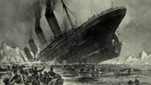
The RMS Titanic
Sank on April 15, 1912
1,316 passengers on board
498 (38%) survived
Can we predict who they are, using ML?
Yes! This is a Kaggle Competition

Slide 3
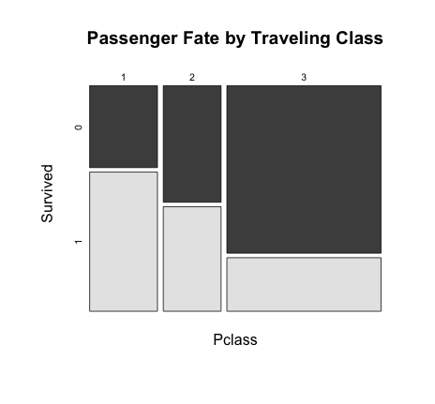
Passenger Class
62% 47% 24%

Slide 4
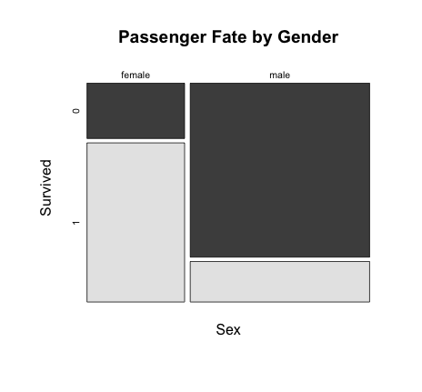
Gender
74% 19%

Slide 5
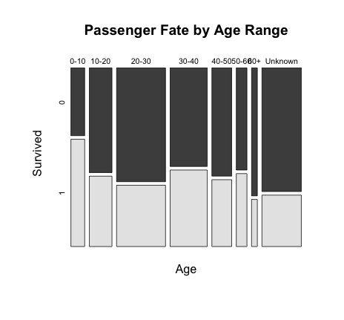
The Children Survive
…those with unknown ages perish

Slide 6
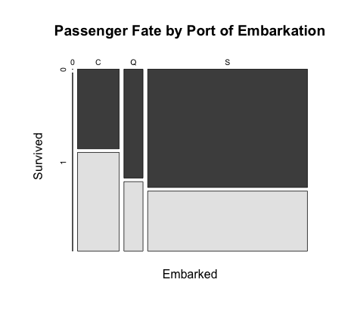
Embarkation is less significant
(C = Cherbourg; Q = Queenstown; S = Southampton)

Slide 7
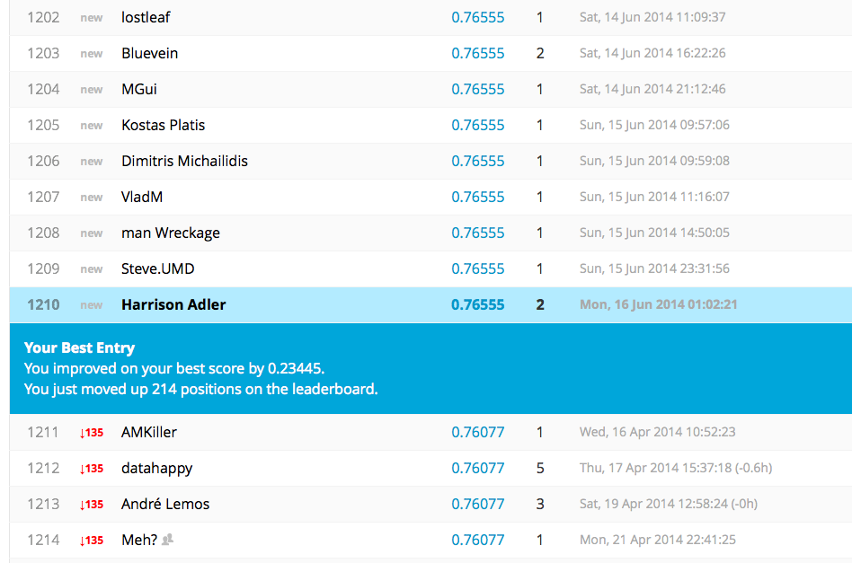
Logistic Regression
Generalized Linear Model
glm(formula = Pclass + Sex + AgeRange + SibSp)
Can I improve?

Slide 8
Name Analysis
Length of Name
Last Letter of Last Name
c
f
Perished
Survived

Slide 9
Revised Logistic Regression
Generalized Linear Model
glm(formula = Survived ~ Pclass + Sex + AgeRange + SibSp + Length + EndsinF + EndsinC)
Can I improve?
 | Reference
Predicted |  | 0 | 1
 | 0 | 109 | 26
 | 1 | 6 | 38

Slide 10
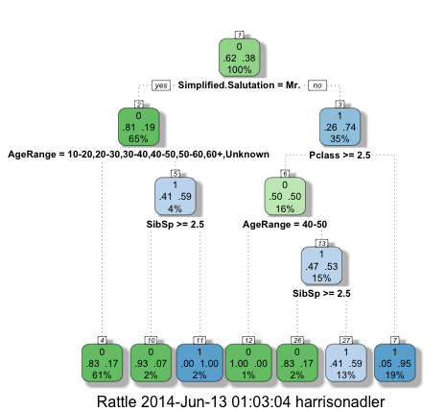
Decision Tree – Without Length

Slide 11
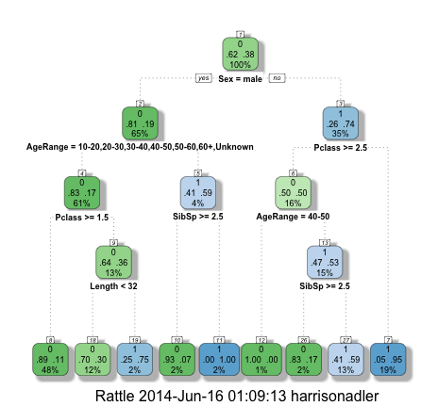
Decision Tree – With Length

Slide 12
So what did I learn?
Notes:
Anyone can participate in Kaggle
Challenge is how to distinguish yourself
Insights may be interesting, but may not actually lead to much of an improvement in the model

